Slide 1
?
?
4
what are the
Pillars of an effective
of an effective website?
PRESENTED BY:
Dale Shadbegian, Founder
118GROUP Web Design
www.118GROUP.com
SPECIAL THANKS:

Slide 2
About 118GROUP
Who We Are
Why are We Here
This will be PAINFULLY obvious.
Information Sources:
TIP: Stats and studies are not the Gospel. They evolve over time. View them as guidelines. Use your best judgement for what applies to you. Your customers feedback will always be your best Analytic!

Slide 3
Define: “Effective”
Adjective
successful in producing a desired or intended result.
fulfilling a specified function in fact, though not formally acknowledged as such.
Synonyms: successful, effectual, potent, powerful

Slide 4
Positioning
Best
Practices
Creativity
Sanity
Check
4
Pillars of an Effective Website

Slide 5
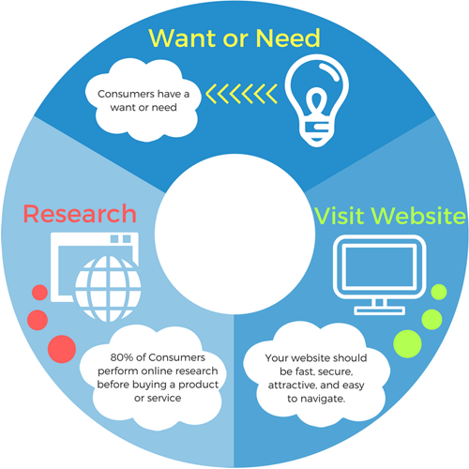
“Typical” Digital Consumer Behavior
“Want or Need” - triggered by a thought, a friend, an email, or ads!

Slide 6
Positioning - Align with Business Goals
a. List your main goals. A “place to go”? Sell stuff? Convey your passion? Call you? Email You? Educate? Accept Donations?
b. Identify Target Visitors Audience 1: Ages 30-55, Professionals of Industry ______ who ________ Audience 2: People who are just plain tired of _________
c. What BIG problem do you solve? 1-2 sentences you want people to know if you only had 8 seconds to tell them.
d. What specific Information do you want to list? HINT: Must support #1 above.
TIP: Identify decision makers and get them involved for this exercise.

Slide 7
2. Best Practices
1. Fast Loading (under 4 seconds). Optimize images for size. Optimize Code. Look up Google PageSpeed
2. Secure SSL - is a MUST (patched and monitored no hack warnings). GravityScan, Sucuri provide free scanners
3. Mobile (almost) First This does a decent job: http://quirktools.com/screenfly
4. High Focus: “Above the Fold” 1-2 Sentence Positioning Statement Geared toward your audience.

Slide 8
2. Best Practices (p2)
5. Demonstrate Market Leadership. Prove you can handle your target visitor with success. Give examples, provide testimonials. Be Authentic… use 1-2 sentences. Try to only reference product and services you still offer.
6. Uncluttered. Think Grid (Left to Right, Top to Bottom).
7. WordPress: Pick a theme with flexibility and longevity. Some designers will create a “custom website”. But their coding skills may be lacking, and they may not foresee how the mobile landscape and the web is changing. Make sure you can “take your website somewhere else”.

Slide 9
2. Best Practices (p3)
8. Consistent Fonts Keep headings and text blocks consistent with style, size, and color. Go in descending order: H1, H2, H3, etc
9. “Professional” Be consistent about design and colors. Use large, high quality photos. Feature the kinds of products and services your customers ask about - and you still offer. Are you using more cons or photos? Are you pantone, colorful, or muted?
10. Accessibility Avoid text / image collision. Whitespace. Contrasting Colors. Try tabbing through your website.
11. Gift Cards Whether you offer Gift Cards or not, list it on the website.

Slide 10
2. Best Practices (p4)
12. Easy Access to the Most Important Info Phone (tap for mobile devices to call). Directions (tap for mobile devices to maps/directions). Live Chat or Book Now. Put on top of website - Make sure it’s visible on desktop, mobile, tablet.
13. How is your site used? Google Analytics - What pages are visited? Where are they coming from? What are their demographics? Try out heat maps.
14. SEO - (Check out 118GROUP.com) Click Get “Found” Citations - Backlinks - Good “Code” on your page - Submitting Sitemaps - Crawl Errors and Broken Links.

Slide 11
3. Creativity: The Next Level
Meaningful Professional Photography. Hire a professional, or try unsplash, pixabay, photodune, pexels, adobe stock if you are in an absolute pinch.
Use of “negative space” or whitespace.
Mathematically coordinating color palette. (check out colorhexa.com)
Add a fun background (try a parallax).

Slide 12
3. Creativity: Play with Typography
I mentioned be consistent… right?
fonts, sizes, colors, capitalization, punctuation.
Break rule #1 sparingly to be FUN or to place emphasys.
LESS is MORE.

Slide 13
4. Sanity Check.
Did I Satisfy the First 3 Pillars?
Start with the basics.
Original Goals Met?
Best Practices Meets Creativity.
Messaging: Am I hitting all points of the buying cycle?
Does each page say EXACTLY what I want in the least amount of word possible.
Grammar & Spelling!
LET GO. Don’t drive yourself mad creating the perfect website.

Slide 14
Examples, Q&A
http://www.wowbao.com
https://www.marriott.com
http://metbostonlimo.com
https://www.parkcentralny.com
Dale Shadbegian, Founder
118GROUP Web Design
Website: www.118Group.com Phone: (508) 417-4189 Email: Team@118Group.com

